Slide 1
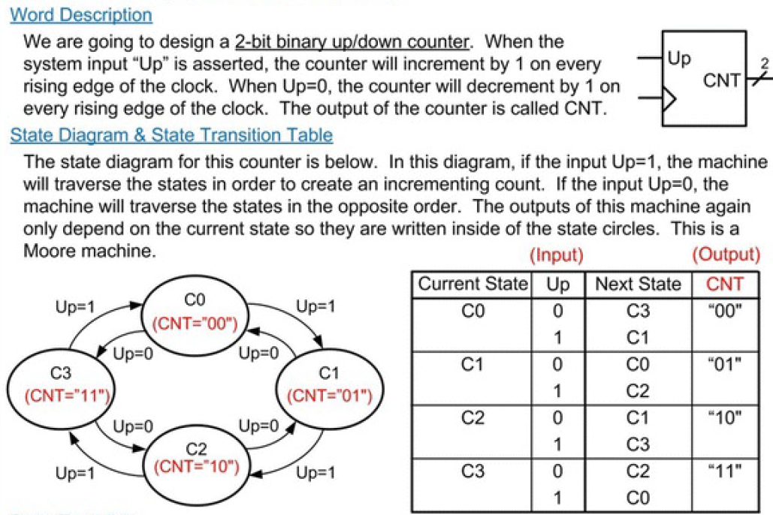
2-Bit Binary Up/Down Counter

Slide 2
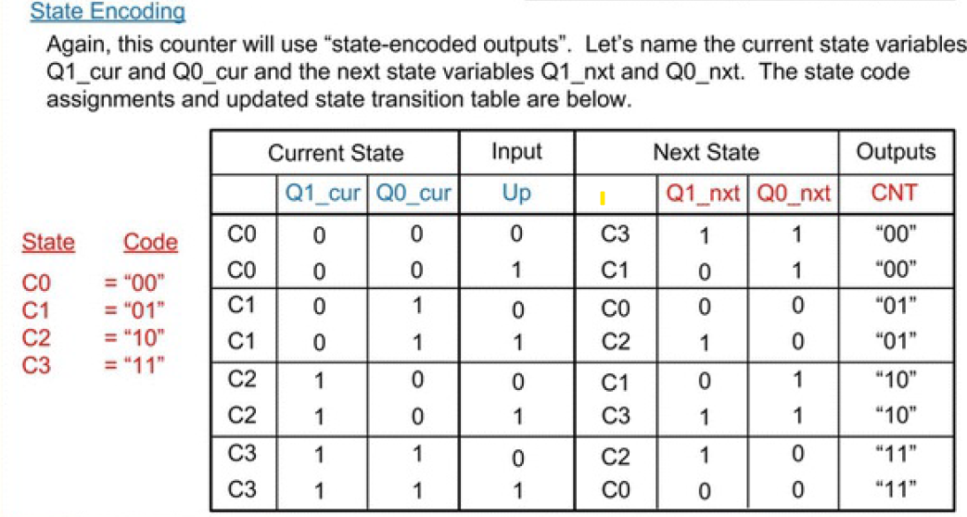
2-Bit Binary Up/Down Counter

Slide 3
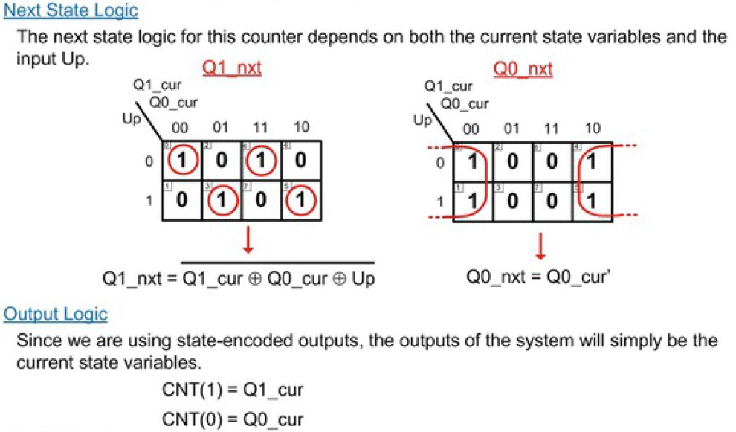
2-Bit Binary Up/Down Counter

Slide 4
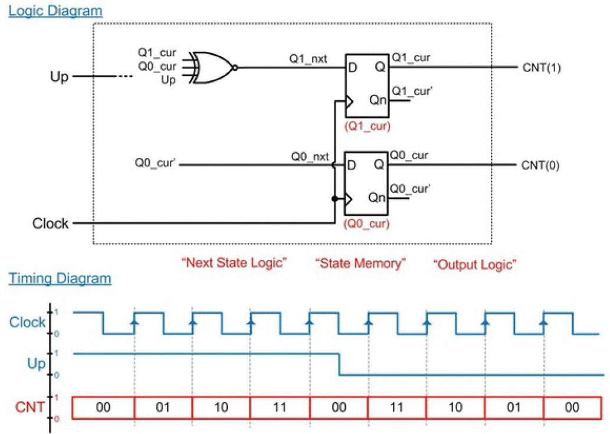
2-Bit Binary Up/Down Counter

